Slide 1

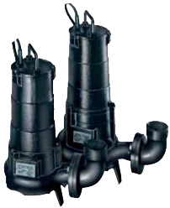
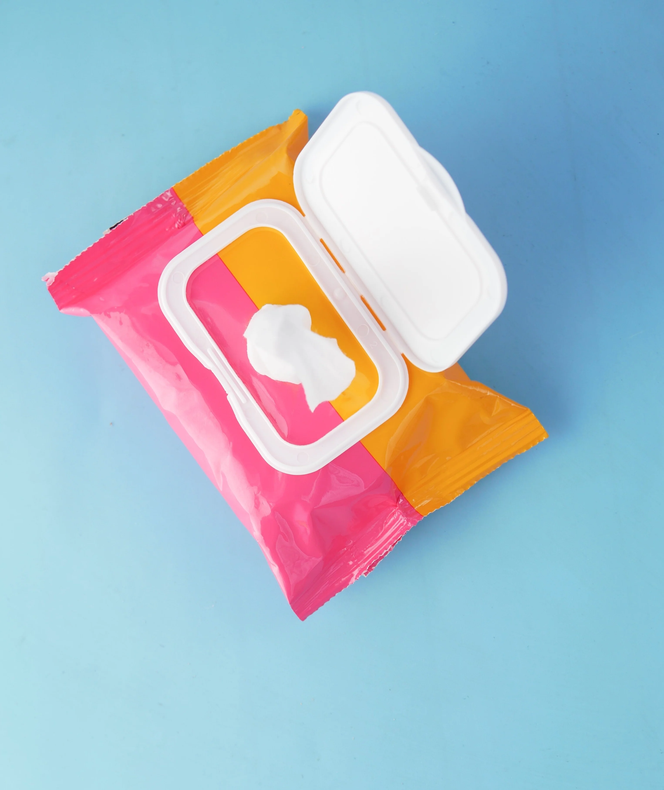
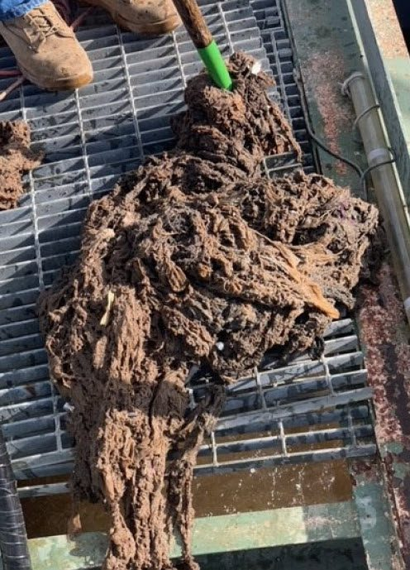
Pumps v wet wipes
+
=

Slide 2
Educational piece
This presentation at a glance:
The confusion and the little guidance on what is flushable and non-flushable.
Problems and consequences of our actions.
Why are we in this situation when there is an easy solution is at hand ?
What intervention is taking place ?
Ultimately; who is responsible ?
Notes:
Point 1 – So we will be looking at the perceived confusion around wet wipes, and how this influences the problem.
Point 2 –
Point 3 –
Point 4 –
Point 5 – Us. The consumers. And we all have a joint responsibility to protect our infrastructure and environment.

Slide 3
What’s actually causing the problem ?
Majority of recovered blockage material comprised of non-flushable wipes. (not designed to be Flushed)
Baby wipes accounted for 75% weight of identifiable products.
Surface wipes / feminine hygiene and cosmetic wipes accommodated for 20% weight of identifiable products.
Between 1-2% of recovered product by weight identified was wipes designed for being flushed. [2]
Notes:
So this was taken from a summary study which consisted of investigating a wastewater utility catchment area and gaining information on the composition on both:
-sewer blockages and pump blockages.
The information gained was to be used to determine interventions to combat the incorrect disposal of problematic flushables.
Read out the rest of the points.
Point 1-
Point 2-
Point 3-
Point 4.

Slide 4
What do we mean by wet wipes ?
Fall into ‘flushable’ and ‘non-flushable’:
Baby wipes, Cleansing pads, Industrial wipes,
Pain relief pads, Medical wipes, Pet care wipes,
Personal hygiene (KFC hand wipes), Toilet paper alternative.
The reality is that 90% of wipes on the market are manufactured from plastic textiles such as Polyester or Polypropylene. [1]
Flushable wipes however; do not act like toilet paper and form solid waste.
Notes:
Point 1 - Read
Point 2 - Read
Point 3 –However, flushable products are designed to be based off organic construction that allows for the breadown of the wipe as a result of the kinetic energy when in contact with a pump. They are marketed as such to a consumer so that they are perceptively acceptable to replace toilet paper.

Slide 5
The reality
83% of all people surveyed across Britain for an independent YouGov survey on behalf of MCS advised that they actually supported the claim of removing ‘flushable’ from all wet wipes if they do not meet WIS 4-02-06 as opposed as the current flushable by EDANA.
72% reported using wet wipes.
43% reported using household cleaning wipes.
36% reported using baby / toddler wipes.
35% reported using facial and skincare wipes.
24% reported using moist toilet wipes. [8]
Notes:
European Disposables and Nonwovens Association – These guidelines have been found to not test the wipes in a realistic UK sewerage environment.

Slide 6
Consequences / implications for Water authorities
Reduced maintenance budget due to additional costs for tinkering and jetting
Reduced operational efficiency on site.
Residential distress and compensation
Additional capital expenditure on up stream screening equipment
£100,000,000[3]
80% directly linked to wet wipes [4]

Slide 7
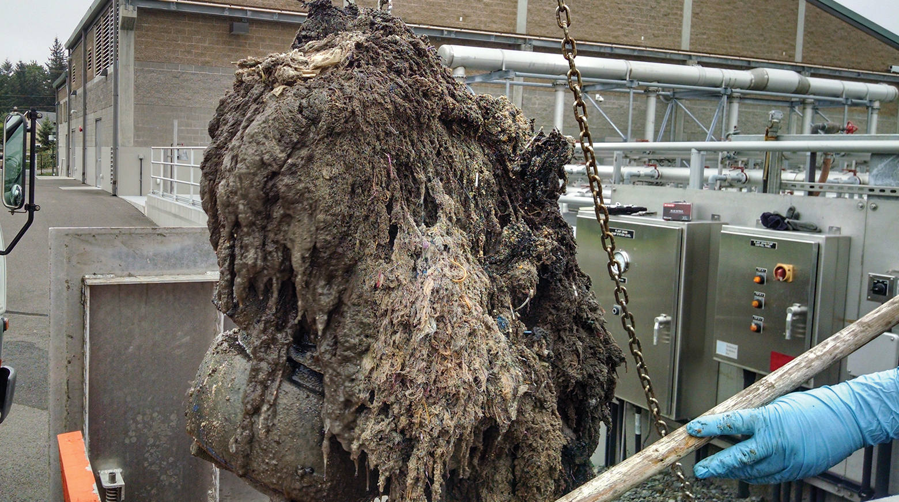
Pump station case study
Typically, unidentifiable mass of wipes.
Higher proportion of non-flushable wipe present in pump station than in the sewer related blockage. (95% in PS, 75% in Sewer)
Limited flushable wipe material (<0.1%)
  Resultant of pumps mechanically being unable to break flushable wipes down.
Notes:
The majority of material in this pumping station clog was an unidentifiable mass of wipes.
However, a single pumping station clog where individual products could be recognised; showed that it contained a higher proportion of non-flushable wipes than sewer blockages – At 95% pumping station as opposed to 75% in sewer blockages.
There was limited flushable wipe material (0.09%) identified in the pump clogs in this single sample. Experience suggests that this is because sewage pumps are able to mechanically break the flushable wipes and pass them downstream.
So flushable wipes are more ‘sewer’ friendly than their non-flushable counterparts; however this does not omit their participation in FGO build up and ragging contribution.

Slide 8
Case study
Marine Conservation Society study (YouGov, on behalf of.)
MCS investigation found 10 leading high street ‘self brand’ wipes can be bought which are marketed as flushable; but cannot endorse ‘Fine to flush’.
Marketed as:
Moist toilet tissue.
Toddler training wipes.
Dispersible wipes.
The MCS’s concern is that flushable wipes are being marketed as such based on the industries own guidelines which are insufficient for UK sewer systems. (European, Disposables and Non-wovens Association )
Notes:
The MCS survey of main UK retailers on assessing and labelling of ‘flushable’ and ‘non-flushable’ wet wipes was conducted by YouGov, on behalf of the Society.

Slide 9

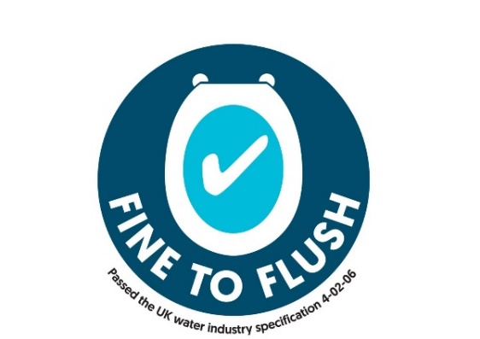
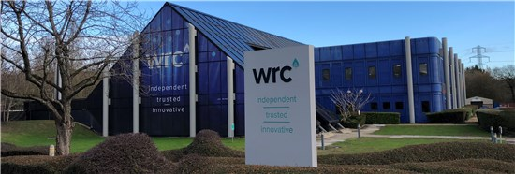
Initiatives to change
Water UK – introduced and passed
WIS 4-02-06. [6,7]
Ensure manufacturers will pass stringent test to use this label on their product.
No plastics to be present in wipes.
Independently tested at a centre of excellence at WRC in Swindon.
Meets the standard = ‘Fine to flush’.
Does not meet standard = ‘Do not flush’.
Notes:
Point 1 - From now on manufacturers of wipes will be able to feature an official water industry ‘Fine to Flush’ symbol on their packaging if they pass strict scientific tests. This symbol will let consumers know that the products don’t contain plastic and will break down in the sewer system instead of clogging up sewers and contributing to fatbergs which cause blockages and sewage overflows.
Although there has been an increase in products being labelled ‘Do Not Flush’, there are many wipes on the market labelled ‘Flushable’ which do not break down quickly when they enter the sewer system, and which would not pass the stringent tests which meet the standard to receive the ‘Fine to Flush’ symbol. The labelling of these products can cause confusion amongst consumers, increasing the problem of sewer blockages.
Manufacturers can have their wipes tested by WRC, water research council.

Slide 10
Benefits of compliance
Improvements to water quality and the environment.
Reduction in sewer gas odours and flooding to homes and the environment.
Municipal authorities being able to improve service to their customers as a direct result of cost savings from expenditure locked up in blockages and servicing.
Increased reputation of manufacturers and retailers for being responsible players in the market.

Slide 11
How can we change ?
Education / clearer information from manufacturers of non-flushable wipes.
Correctly branding any product with Polypropylene / Polyethylene fibre as ‘non-flushable’.
Manufacturers guidance criteria on packaging for ‘non flushable product’
Collaboration between Water industry / manufacturers and retailers.
More stringent use of section 111 of water industry act 1991.
Implement sample studies before during and after corporate and educational campaigns.
Or…we could just follow 1 simple instruction:
Notes:
P1- Education / clearer information from manufacturers of non-flushable wipes.
P2 - Correctly branding any product with Polypropylene / Polyethylene fibre as ‘non-flushable’.
P3 - Manufacturers guidance criteria on packaging for ‘non flushable product’
P4 - Collaboration between Water industry / manufacturers and retailers.
P5 - More stringent use of section 111 of water industry act 1991.
Restrictions on use of public sewers which states no person shall throw, empty or turn, or suffer or permit to be thrown or emptied or to pass, into any public sewer, or into any drain or sewer communicating with a public sewer.
In particular section 1a - any matter likely to injure the sewer or drain, to interfere with the free flow of its contents or to affect prejudicially the treatment and disposal of its contents.
P6 - Implement sample studies before during and after corporate and educational campaigns.
Or…we could just follow 1 simple instruction:

Slide 12
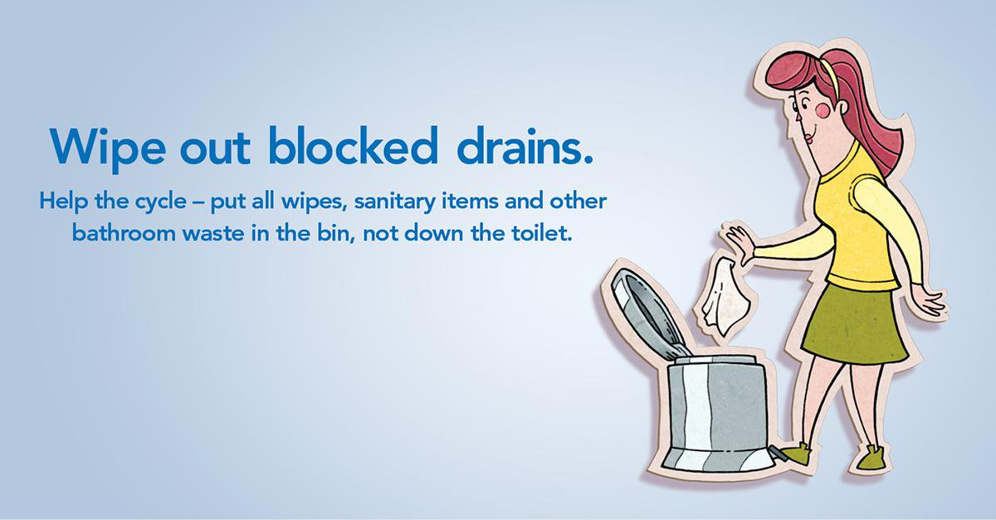
Maybe its time for a radical change. Or perhaps we could make just one small change:

Slide 13
What are we at Pump technology doing to aid the fight against wet wipe blockages?
Speaking to Manufactures regarding their latest offerings.
Looking at your project and choosing the best pump type for you.
Supporting DCG best practice when speaking to Consultants about rising main sizing.

Slide 14
References
[1] Pajda, Aleksandra. "Did You Know Wet Wipes Are Made With Plastic? This Is Why the UK Wants Them Banned". One Green Planet. Retrieved 4 January 2019.
[2] Water UK. Andy Drinkwater, Frank May. Wipes in sewer blockage study – Final report. 2017
[3] BPMA flow magazine Issue 3, Tackling the wet wipe dilemma – Pg 18.
[4] BPMA flow magazine Issue 3, Tackling the wet wipe dilemma – Pg 18.
[5] Bin it – don’t block it – Friends of the earth; https://friendsoftheearth.uk/plastics/wet-wipes-keeping-them-out-our-seas-and-sewers
[6] Water industry specification. Fine to flush: WIS4-02-06. Water UK – January 2019: issue 1.
[7] https://www.waterbriefing.org/home/water-issues/item/15768-uk-water-sector-launches-wet-wipes-flushability-standard
[8] https://www.waterbriefing.org/home/water-issues/item/16154-leading-retailers-not-embracing-wet-wipe-%E2%80%98flushability%E2%80%99-standard-in-own-brand-products
[9] Scottish water website – Pee, toilet paper, poo: the only things to flush down the loo. May 2015 campaign.

